Slide 1
BANK MANAGEMENT SYSTEM
Submitted By : M. Raghavi
Batch Code : 2021 - 6139
Enrolment No :EBEON0921446719

Slide 2
ABSTRACT
Banking application for tellers to perform transactions such as withdraws/deposits, fund transfers, and view transaction statements on user accounts.

Slide 3
APPLICATION DESCRIPTION
The Bank Management System is an application for maintaining a person’s account in a bank.
This Bank Application System lets users create a new account, make cash deposits and withdrawals, access account information all through software without the need of going personally to a bank. This Bank Application System project has been designed in Java and various actions have different panels.

Slide 4
MODULES
The series of menus displayed are as follows:
Display all account details
Search by account number
Deposit the amount
Withdraw the amount
Exit

Slide 5
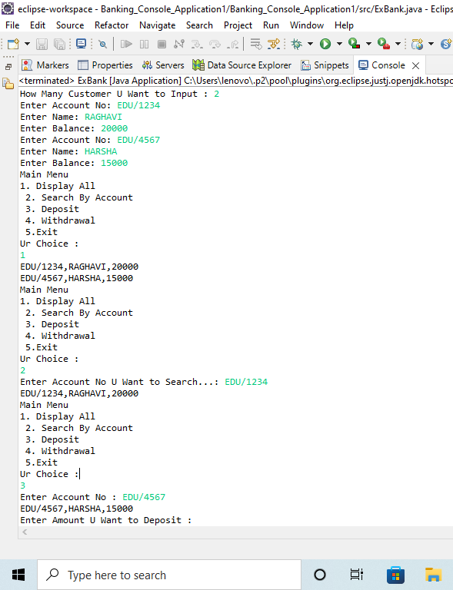
OUTPUT

Slide 6
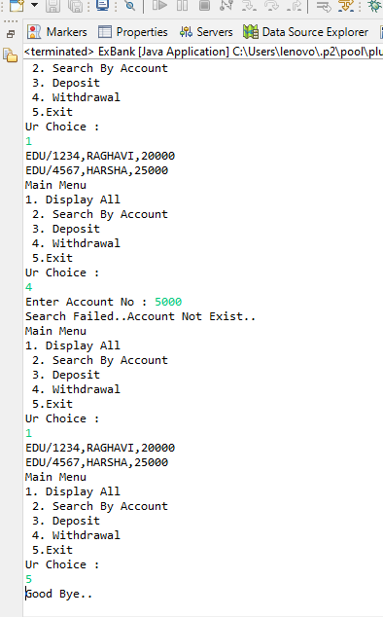

Slide 7
THANK YOU…

